Slide 1
Philadelphia Restaurant Check-ins Forecasting

Slide 2
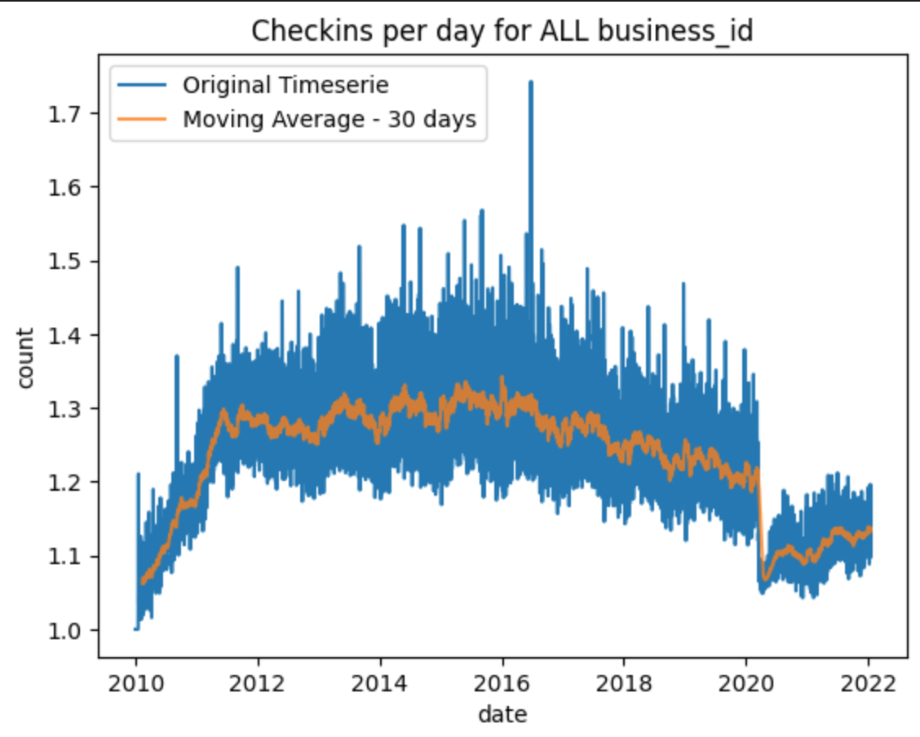
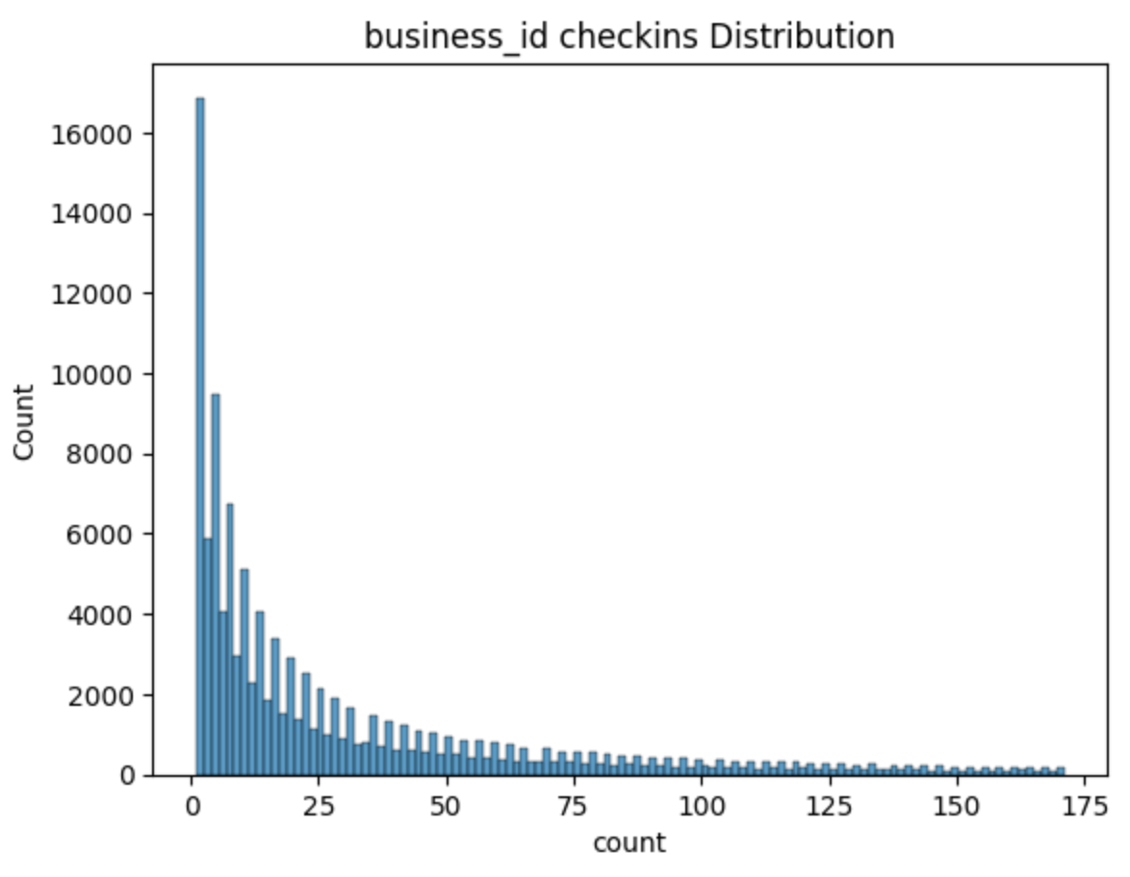
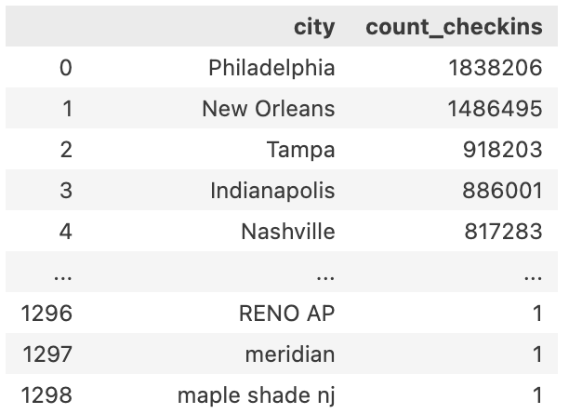
Data Exploration | checkin
Goal: have the city with higher number of checkins to guarantee that there is enough data for the forecasting.
On the graph below we can see peak and low seasons in checkins. It is possible to see that the low season was mainly in Covid time.

Slide 3
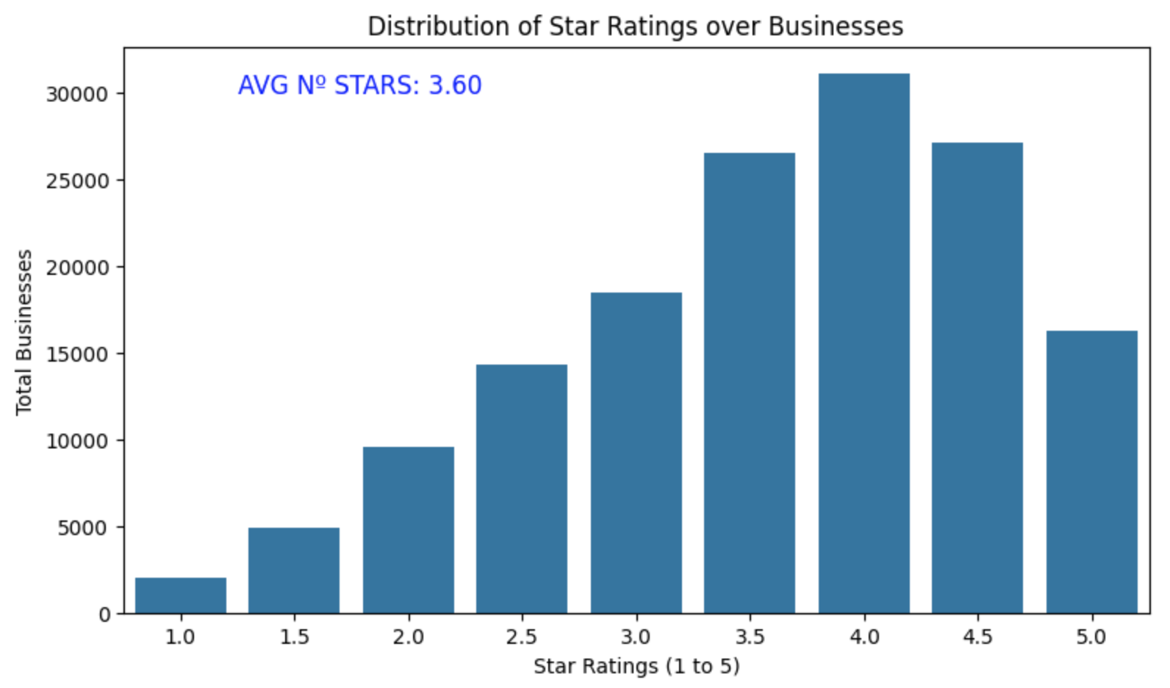
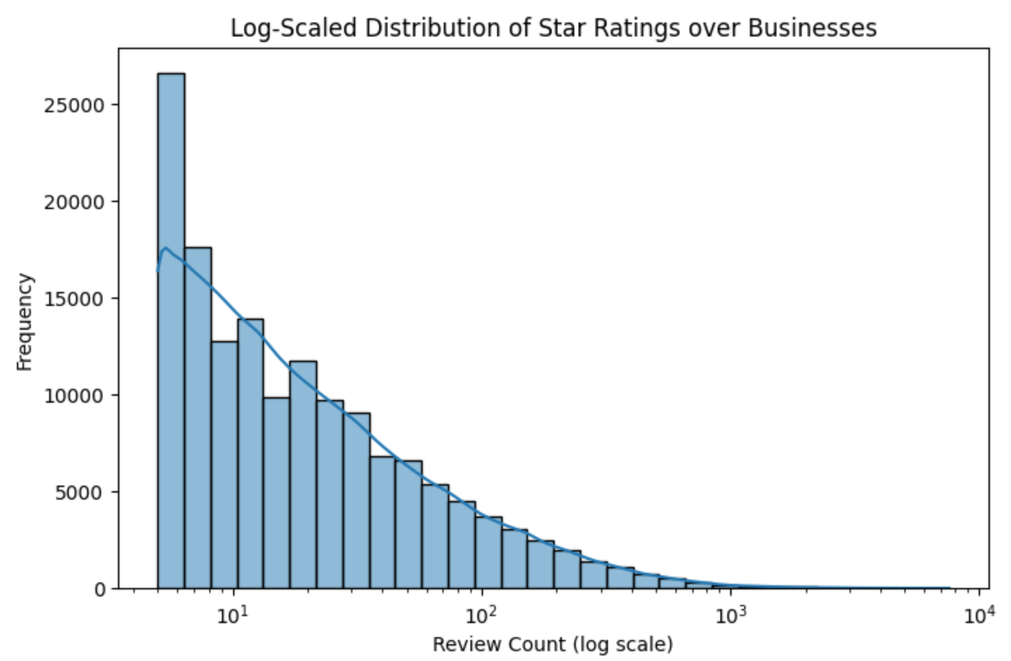
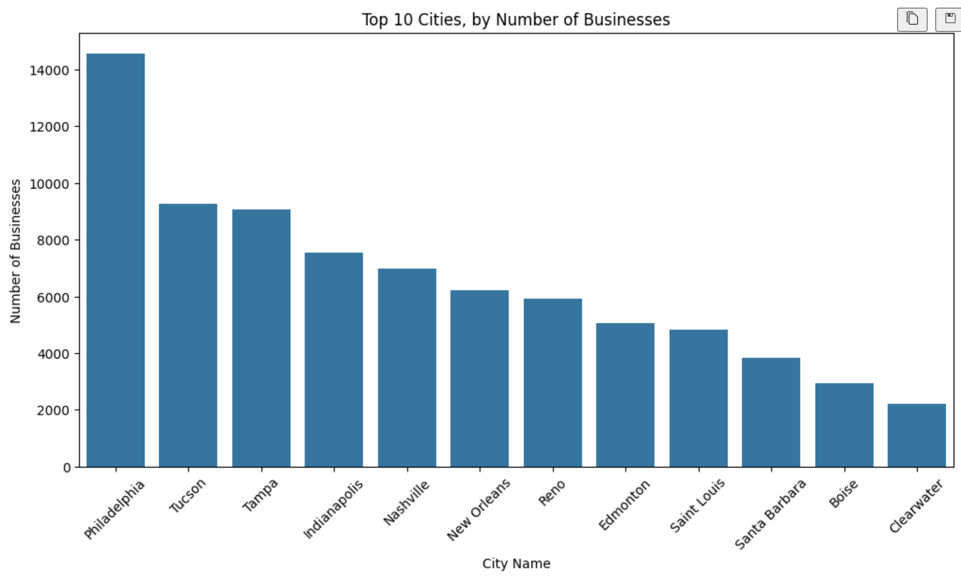
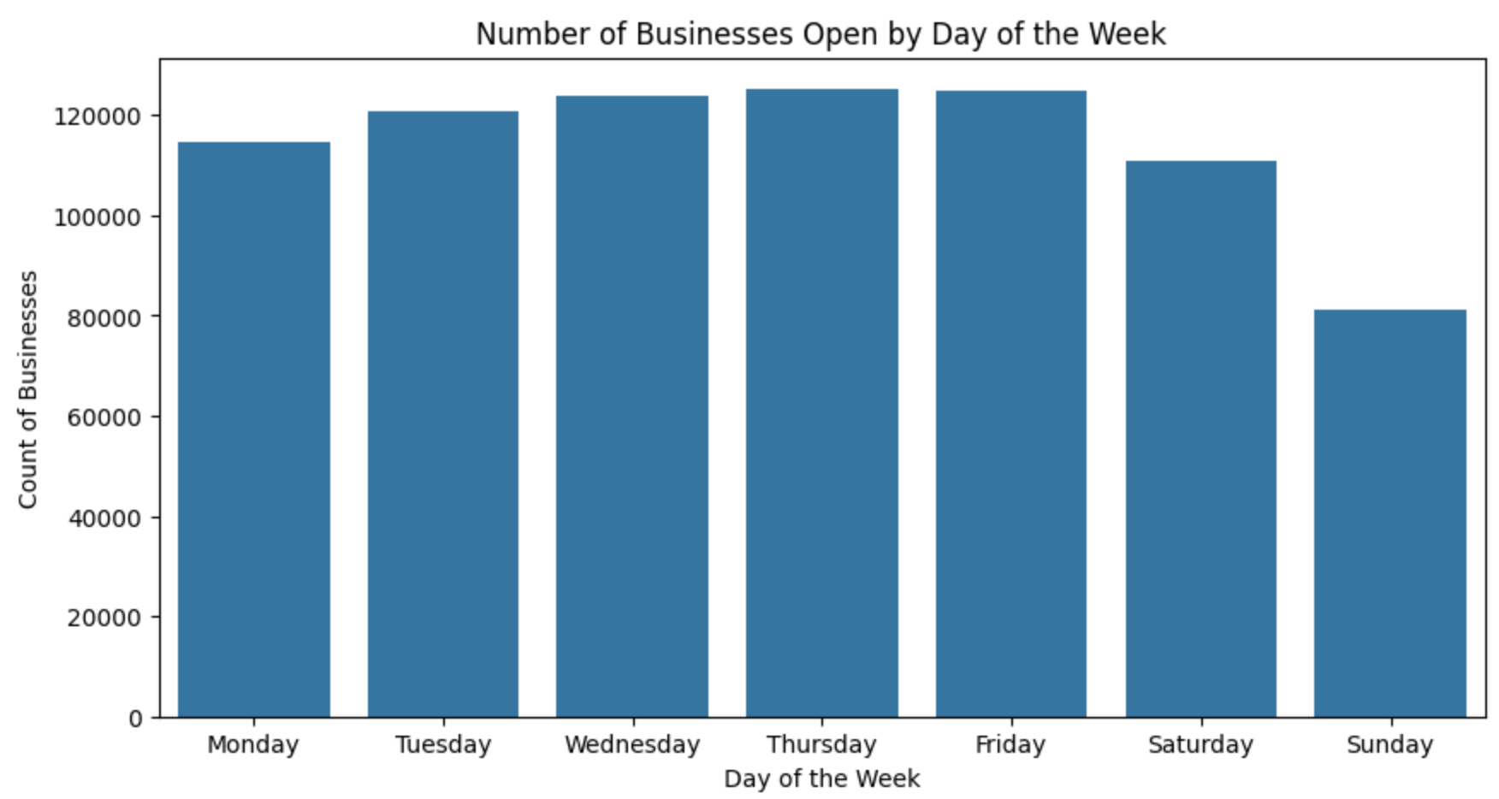
Data Exploration | Business
To better understand the attributes of the restaurants, the average rating, number of business open per day of the week, number of business per city and business distribution was analysed.

Slide 4
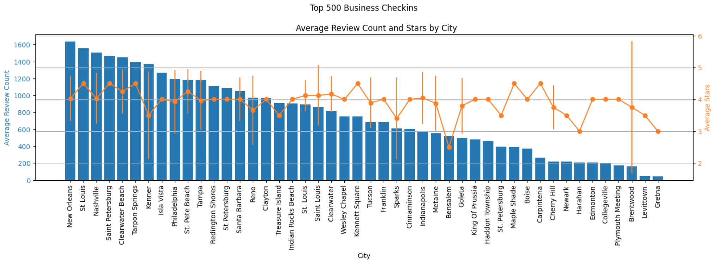

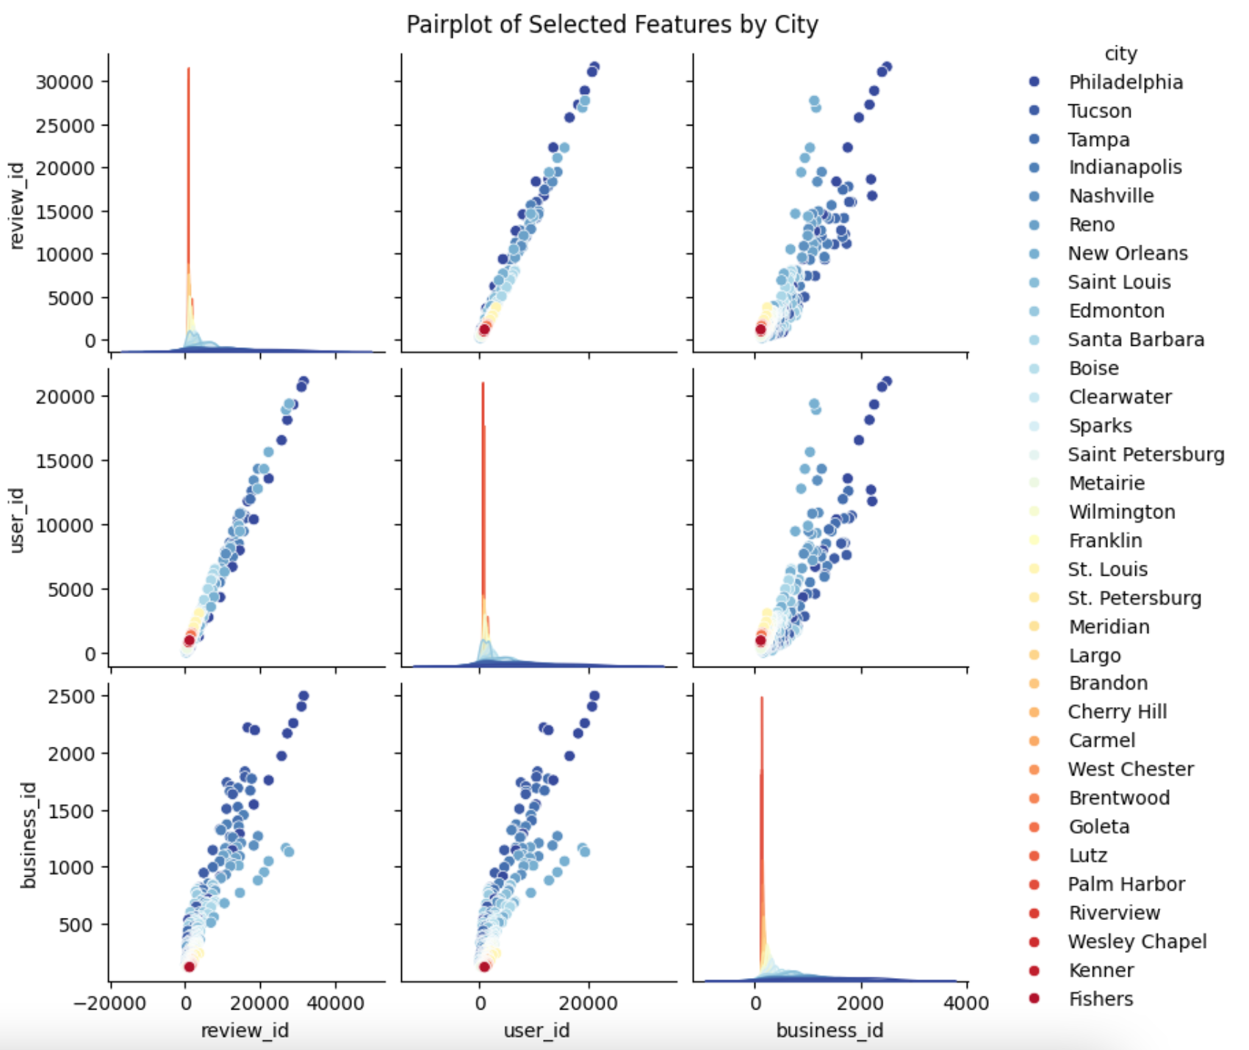
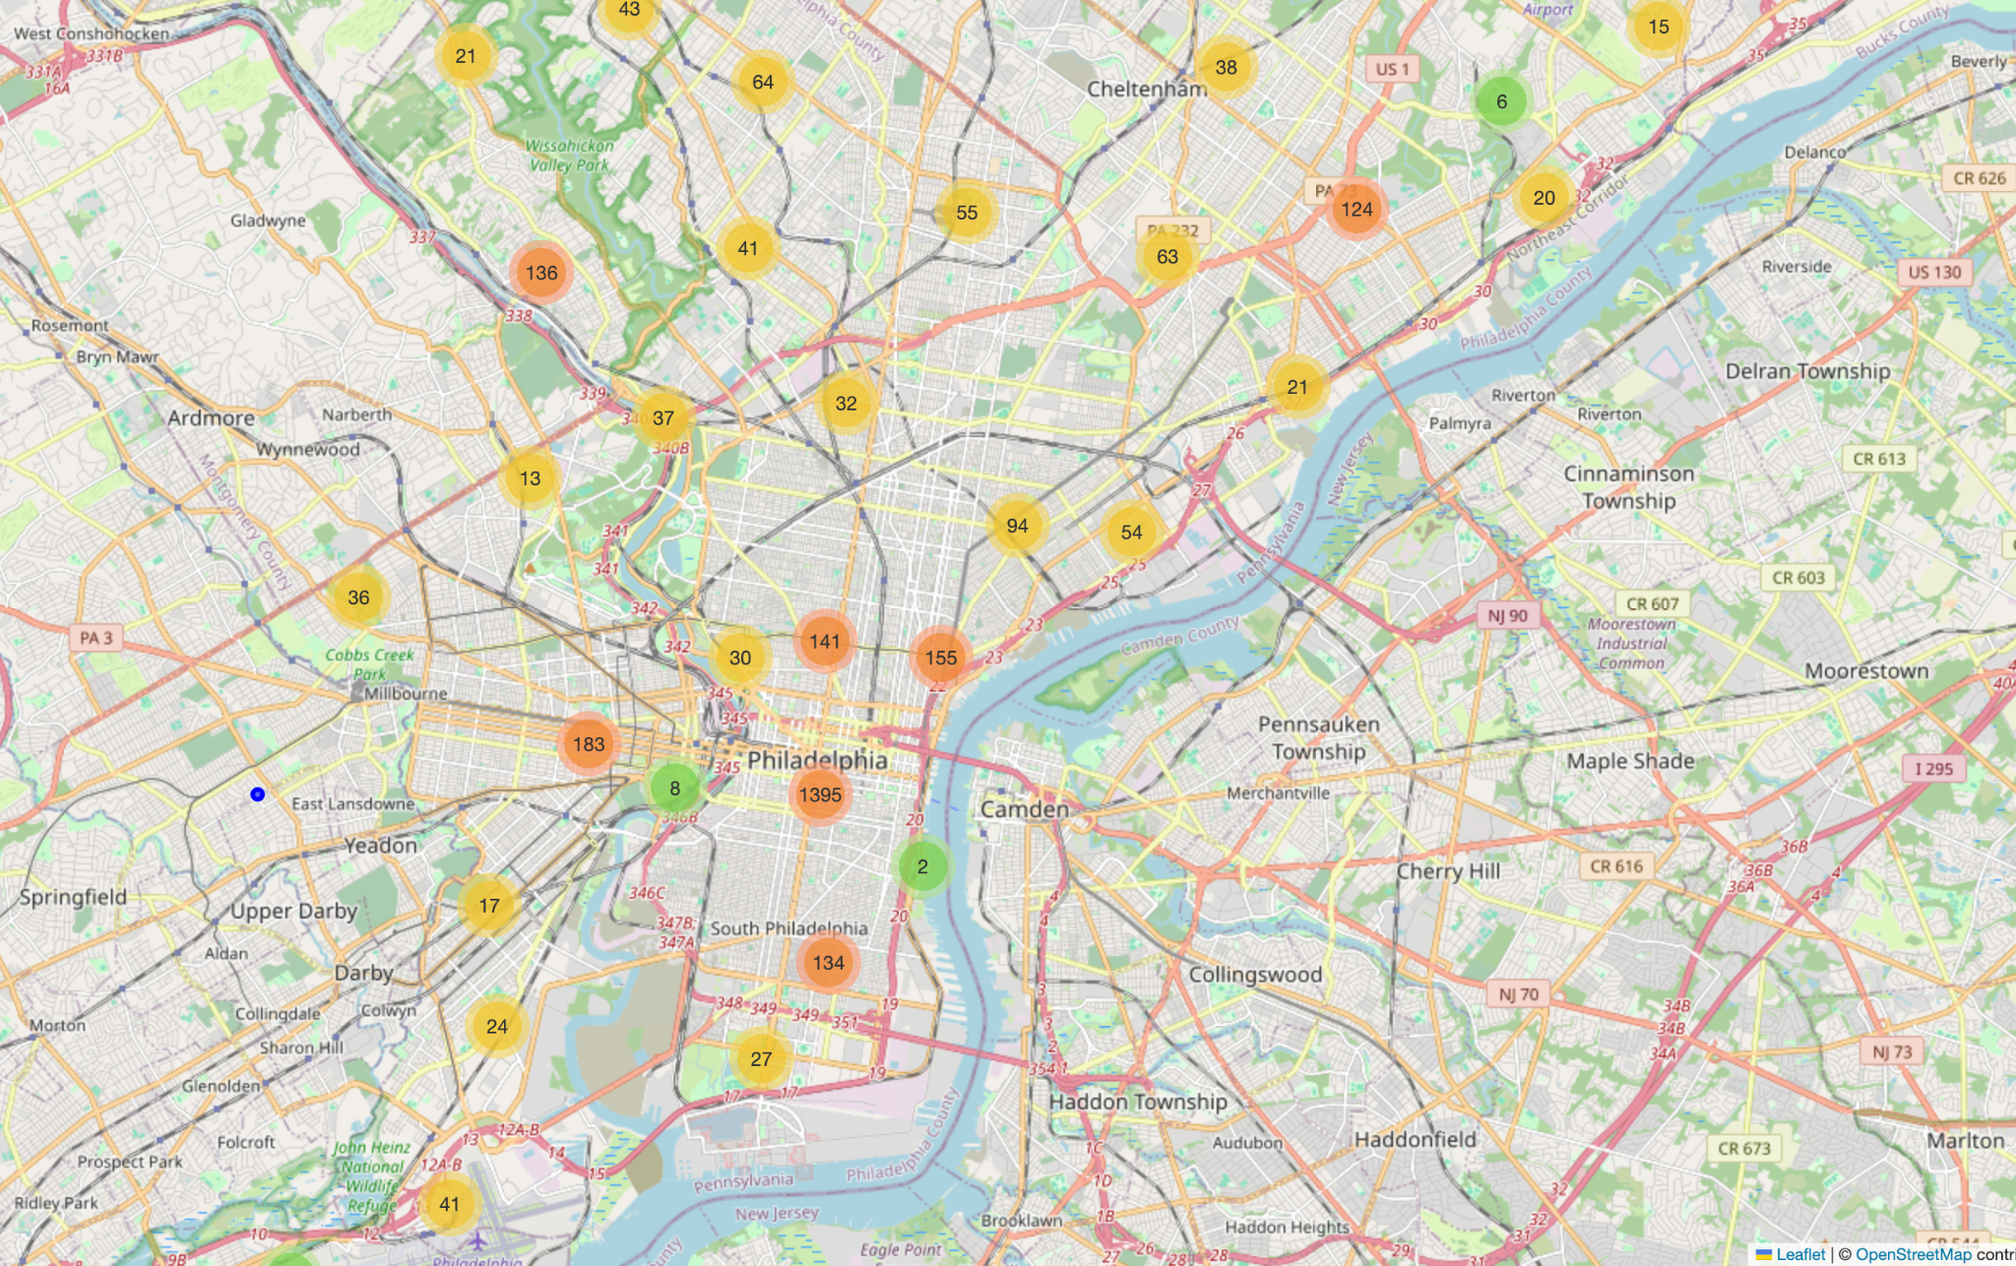
Data Exploration | Reviews

Slide 5
Time Series | Problem Definition
Number of checkins for the chosen community
What to Forecast?
What we want to Forecast?
Forecast of daily check-ins for the Business Ids over the following 30 days.
For which time frame?
Daily
For which horizon?
30 days
Notes:
These helper functions were provided by the UK Biobank and not developed by the paper authors

Slide 6
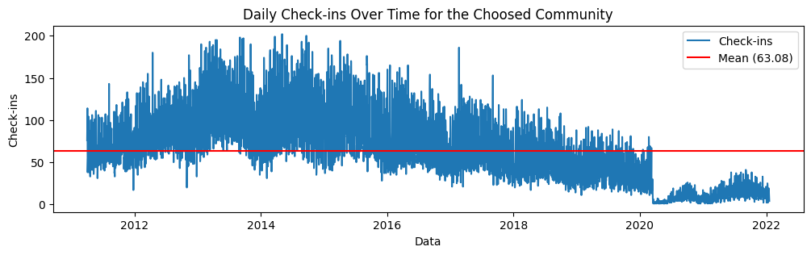
Original Time Series

Slide 7
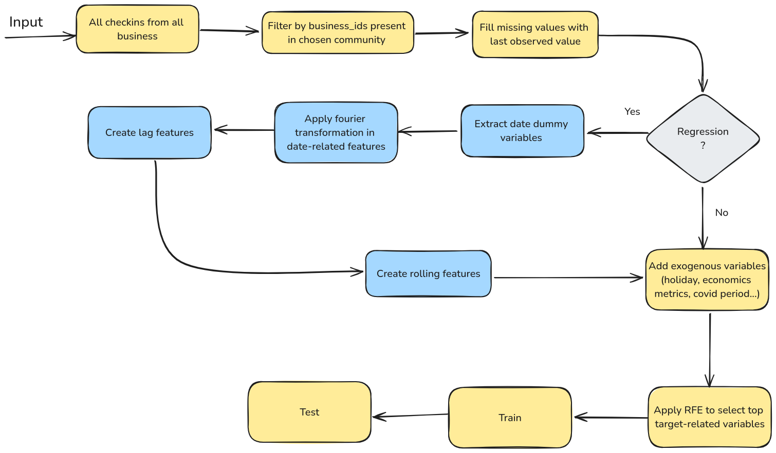
Pipeline
Notes:
Missing Values had been dropped!

Slide 8
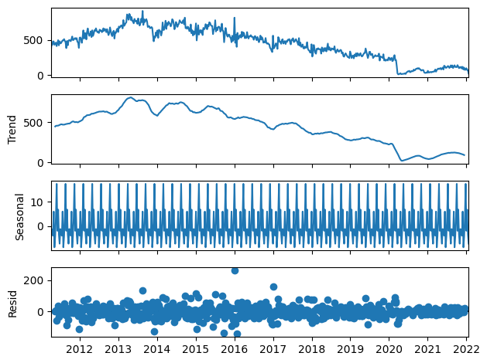
Patterns
Strong seasonal pattern (weekly)
Non-stationary
Decreasing trend
Notes:
These helper functions were provided by the UK Biobank and not developed by the paper authors

Slide 9
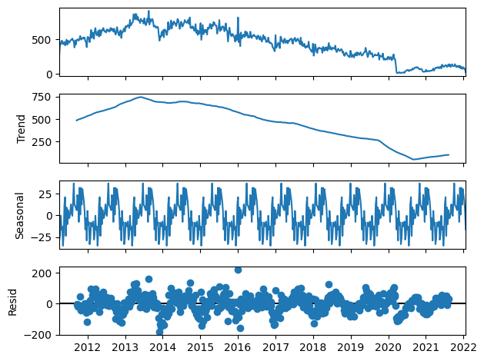
Patterns
Strong seasonal pattern (yearly)
Non-stationary
Decreasing trend
Notes:
These helper functions were provided by the UK Biobank and not developed by the paper authors

Slide 10
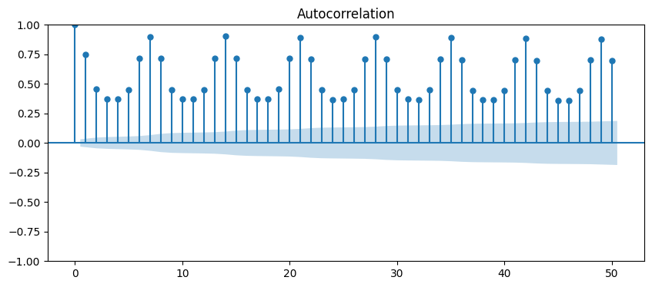
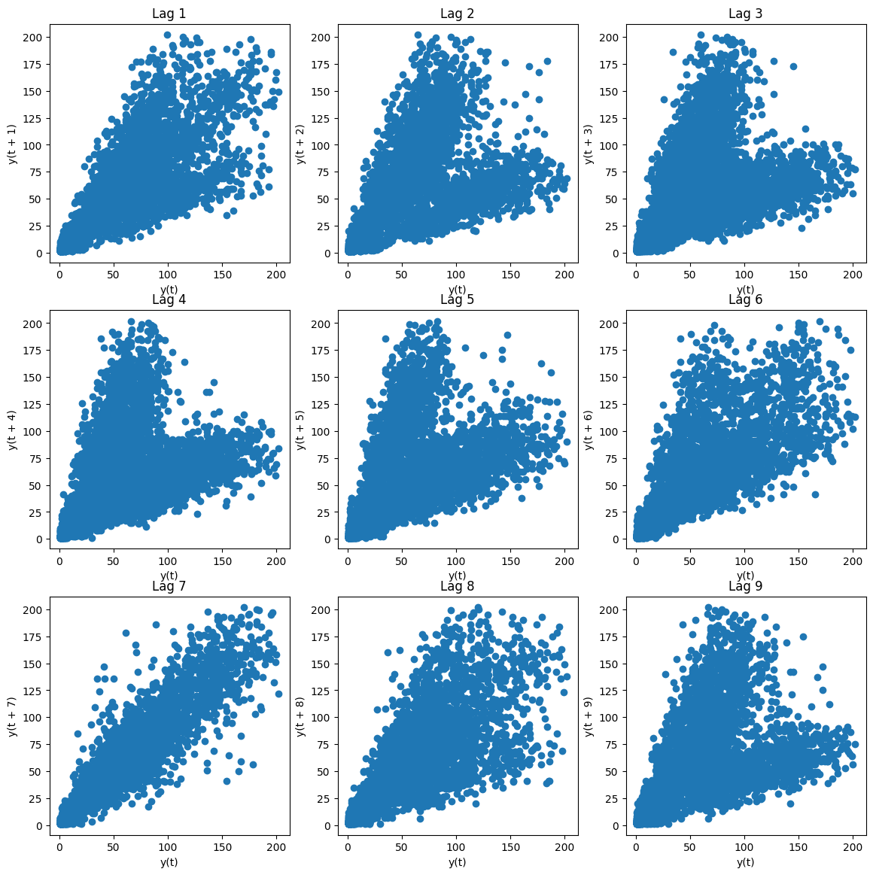
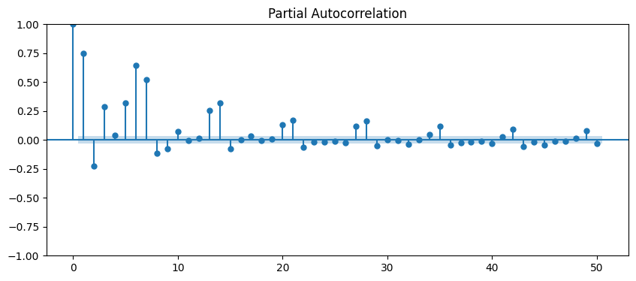
Seasonal Patterns
(weekly)
All analysis lead to a 1-week seasonality interpretation
Notes:
Missing Values had been dropped!

Slide 11
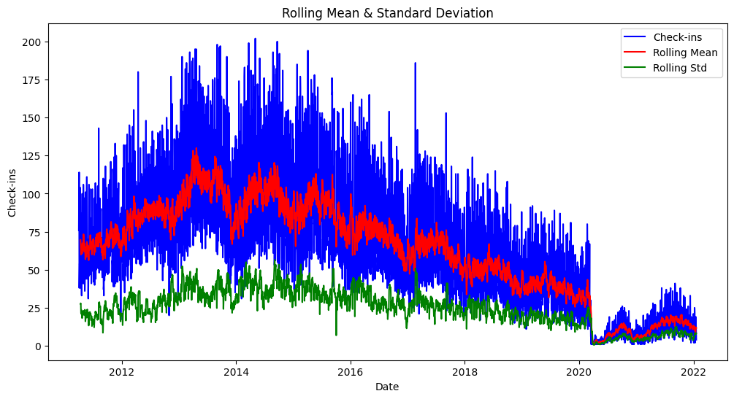
2. Stationarity
As the mean and variance are not constant, the time series appears to be non-stationary
Notes:
One-hot encoding indicates presence or absence of some feature, and the label encoding indicates meaningful order throughout the column.

Slide 12
2. Stationarity: Statistical Approach
Conclusions
ADF Test: cannot prove that the date is stationary
KPSS: The serie has a unit root.
 | ADF Test | KPSS Test
p-value | 0.89 | 0.01
Test Result | Fail to reject the null hypothesis | Reject the null hypothesis
Statistically proven that the data is non-stationary
Notes:
Correlation matrix greater than 0.4 with mental impairment and heart diseases selected + those variables in the slides.

Slide 13
3. Trend
Conclusions
Long peaks on the ACF chart and a gradual decline on the PACF indicate the presence of a trend
Notes:
Correlation matrix greater than 0.4 with mental impairment and heart diseases selected + those variables in the slides.

Slide 14
3. Trend: Statistical Approach
 | Mann-Kendall Test
p-value | 0.01
Test Result | Reject the null hypothesis
Trend | Decreasing
Slope | 0.02
Statistically proven that the data has a decreasing trend
Notes:
Correlation matrix greater than 0.4 with mental impairment and heart diseases selected + those variables in the slides.

Slide 15
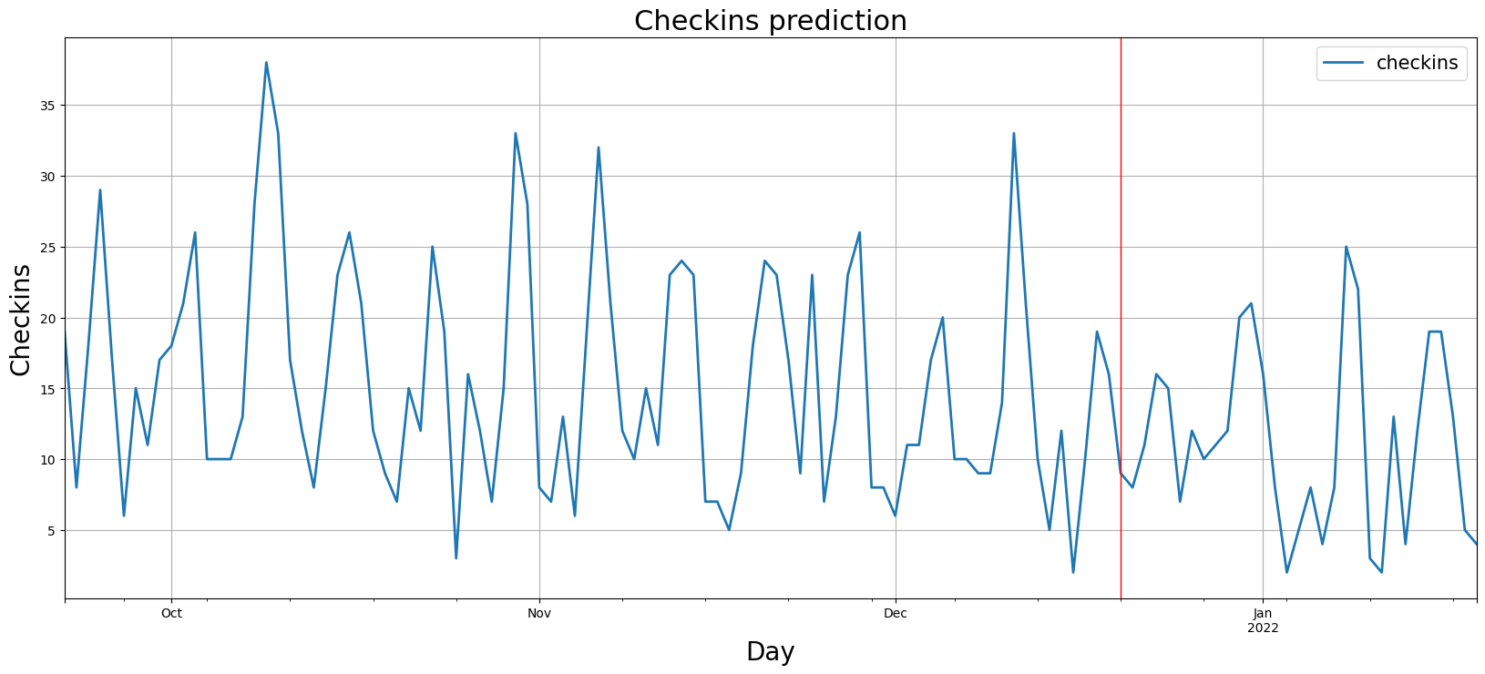
Models
Train
Test
ALGORITHMS
BASELINE
SARIMA;SARIMAX; ETS
Random Forest; Linear regression; XGBOOST
SPLITTING THE DATA
Train: Initial date - ‘20-12-2021’
Test: ‘20-12-2021’ - Final date
‘20-12-2021’: Last month

Slide 16
Pipeline
Notes:
Missing Values had been dropped!

Slide 17
From Time Series to Regression - Dummy Variables
Date | y
01-01-2012 | 75
02-01-2012 | 86
03-01-2012 | 61
04-01-2012 | 62
05-01-2012 | 67
06-01-2012 | 73
07-01-2012 | 112
08-01-2012 | 99
Date | y | day | month | year | quarter | …
01-01-2012 | 75 | 1 | 1 | 2012 | 1 | …
02-01-2012 | 86 | 2 | 1 | 2012 | 1 | …
03-01-2012 | 61 | 3 | 1 | 2012 | 1 | …
04-01-2012 | 62 | 4 | 1 | 2012 | 1 | …
05-01-2012 | 67 | 5 | 1 | 2012 | 1 | …
06-01-2012 | 73 | 6 | 1 | 2012 | 1 | …
07-01-2012 | 112 | 7 | 1 | 2012 | 1 | …
08-01-2012 | 99 | 8 | 1 | 2012 | 1 | …
Notes:
Missing Values had been dropped!

Slide 18
From Time Series to Regression - Fourier Transformation
Date | y
01-01-2012 | 75
02-01-2012 | 86
03-01-2012 | 61
04-01-2012 | 62
05-01-2012 | 67
06-01-2012 | 73
07-01-2012 | 112
08-01-2012 | 99
Date | y | day | sin_day | cos_day | …
01-01-2012 | 75 | 1 | 0.59 | 0.23 | …
02-01-2012 | 86 | 2 | 0.69 | 0.45 | …
03-01-2012 | 61 | 3 | 0.63 | 0.32 | …
04-01-2012 | 62 | 4 | 0.78 | 0.31 | …
05-01-2012 | 67 | 5 | 0.89 | 0.46 | …
06-01-2012 | 73 | 6 | 0.32 | 0.57 | …
07-01-2012 | 112 | 7 | 0.52 | 0.98 | …
08-01-2012 | 99 | 8 | 0.12 | 0.58 | …
Notes:
Missing Values had been dropped!

Slide 19
From Time Series to Regression - Lag and Rolling Variables
Date | y
01-01-2012 | 75
02-01-2012 | 86
03-01-2012 | 61
04-01-2012 | 62
05-01-2012 | 67
06-01-2012 | 73
07-01-2012 | 112
08-01-2012 | 99
Date | y | lag_1 | lag_2 | lag_mean_7 | …
01-01-2012 | 75 | … | … | … | …
02-01-2012 | 86 | 75 | … | … | …
03-01-2012 | 61 | 86 | 75 | … | …
04-01-2012 | 62 | 61 | 86 | … | …
05-01-2012 | 67 | 62 | 61 | … | …
06-01-2012 | 73 | 67 | 62 | … | …
07-01-2012 | 112 | 73 | 67 | … | …
08-01-2012 | 99 | 112 | 73 | 76,57 | …
Aggregated mean from the previous week
Notes:
Missing Values had been dropped!

Slide 20
From Time Series to Regression - Exogenous Variables
Date | y
01-01-2012 | 75
02-01-2012 | 86
03-01-2012 | 61
04-01-2012 | 62
05-01-2012 | 67
06-01-2012 | 73
07-01-2012 | 112
08-01-2012 | 99
holiday | covid | gdp | consumer_rate | inflation_rate | …
1 | 0 | 15557.53 | 9.1 | 0.643 | …
0 | 0 | 15557.53 | 9.1 | 0.643 | …
0 | 0 | 15557.53 | 9.1 | 0.643 | …
0 | 0 | 15557.53 | 9.1 | 0.643 | …
0 | 0 | 15557.53 | 9.1 | 0.643 | …
0 | 0 | 15557.53 | 9.1 | 0.643 | …
0 | 0 | 15557.53 | 9.1 | 0.643 | …
1 | 0 | 15557.53 | 9.1 | 0.643 | …
Notes:
“Gross Domestic Product" and represents the total monetary value of all final goods and services produced (and sold on the market) within a country during a period of time (typically 1 year).

Slide 21
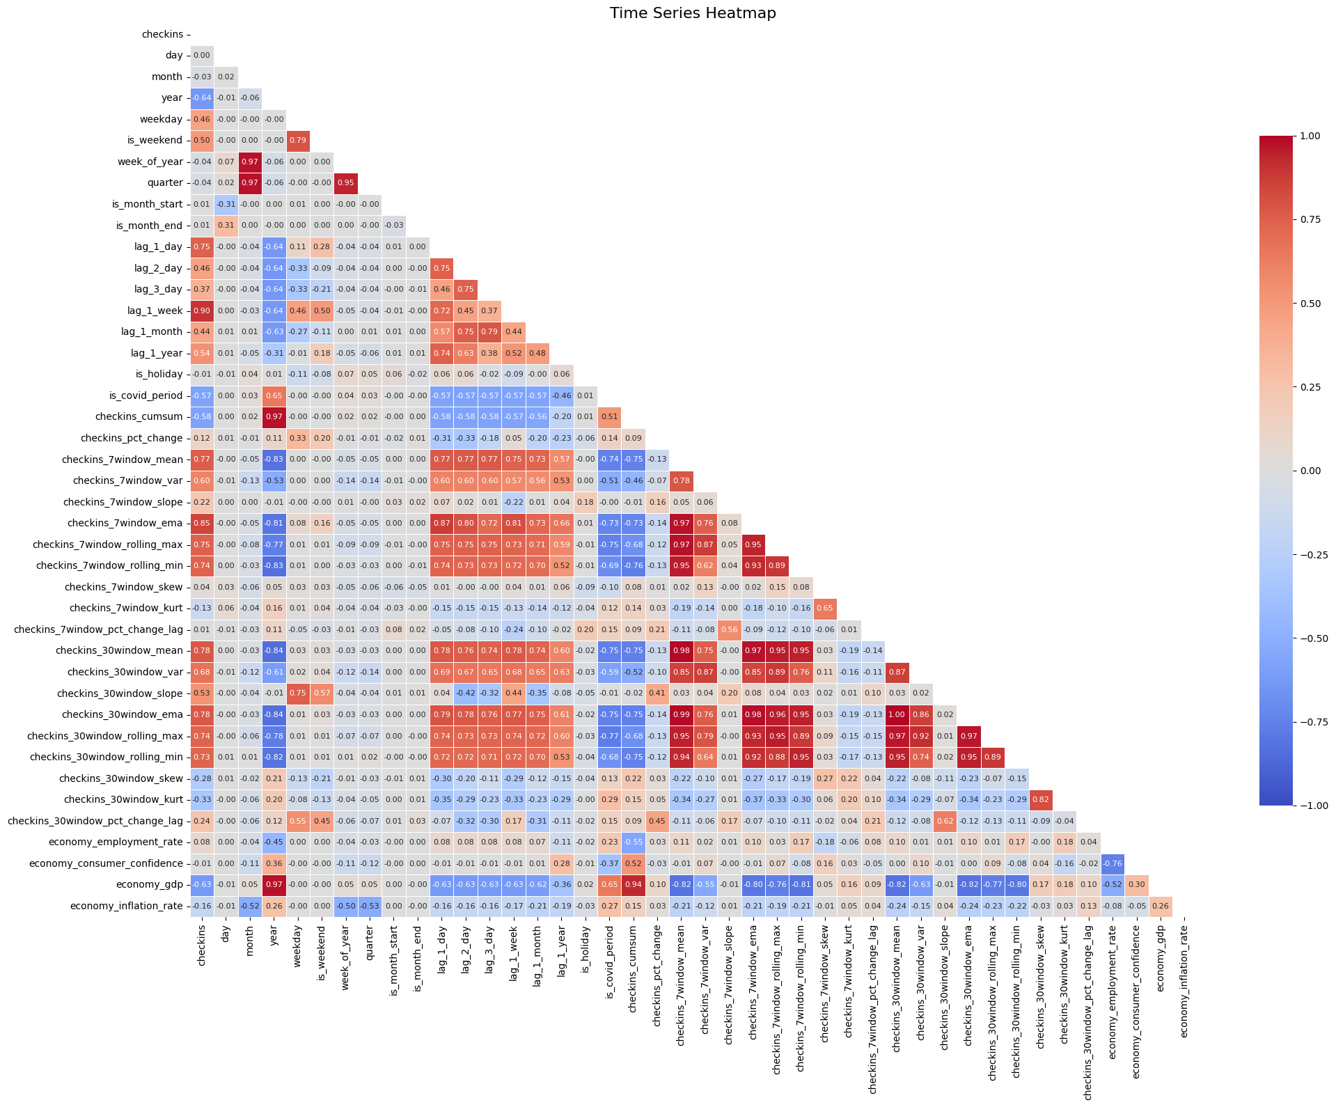
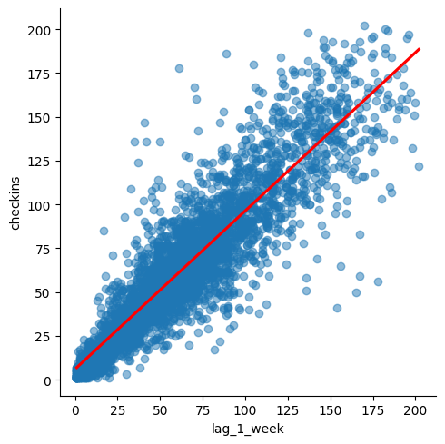
Correlation Analysis
The target variable (checkins) is the first column in the heatmap. We can see good positive and negative correlations among other features and the related target. The variable “lag_1_week” has 0.9 correlation, and because of that is a good estimator, and a linear regression model should perform well using it.
Notes:
Remember to say that it is a linear relationship

Slide 22
Correlation Analysis
We were also able to observe a strong negative correlation with the ‘Year’ feature due to the strong annual seasonality found in the time serie. This allowed the model to predict annual values well.
Notes:
Remember to say that it is a linear relationship

Slide 23
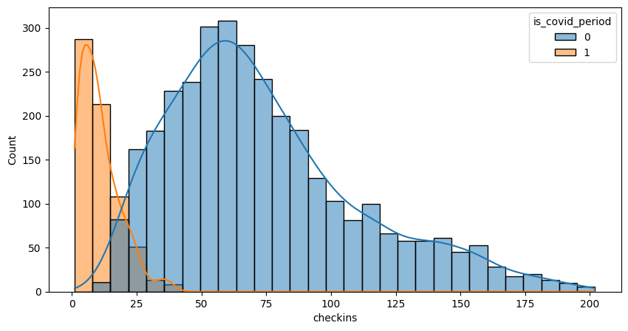
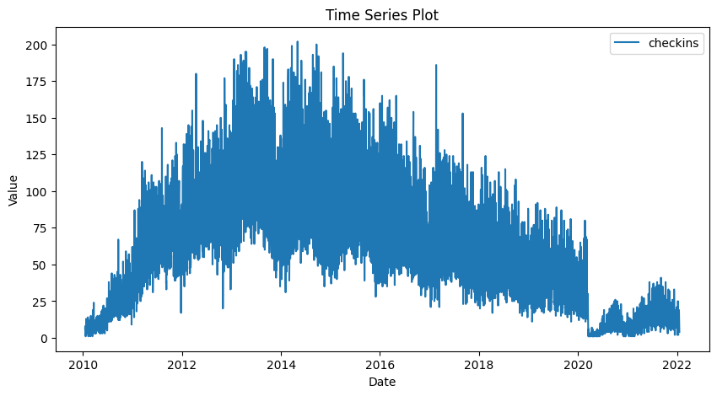
Critical Feature
Due to the horizon belongs to the covid period, creating this binary feature was crucial to identity the drastic unit root below, due to lockdown policies. We can see in the histogram that the distribution during the covid period was concentrated close to zero.
unit root
Notes:
Also the horizon belongs to the covid period

Slide 24
Dimensionality Reduction - RFE
In general, variables related to weeks, years, economy and covid were the most important ones to contribute on the predictions of the models.
Train a ML Model
Top 8 Variables
lag_1_week
checkins_7window_mean
lag_1_year
checkins_30window_slope
checkins_cumsum,
economy_gdp
is_covid_period
year
Get Feature Importance
Remove Least Import Features
Retrain a ML Model with Remaining Features
Notes:
Remember to say that it is a linear relationship

Slide 25
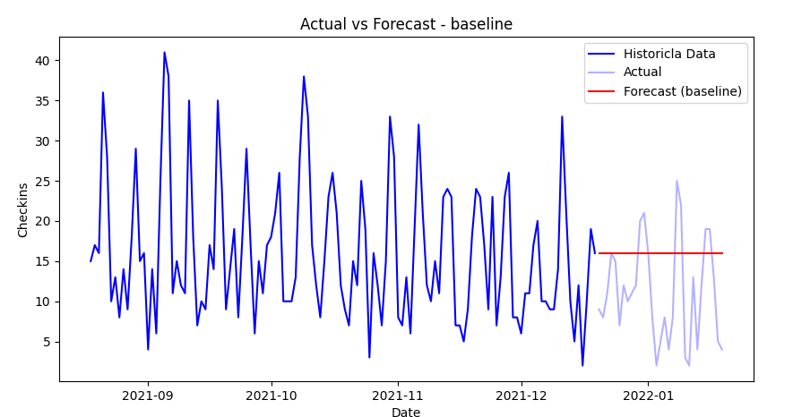
Baseline Model
The baseline for our case was vastly fair to be the last value propagation, due to the huge fall observed during covid pandemic period. We could select the historial mean, however, it would not be a good baseline, since this time series has a level around 65 check ins.
Naive: Propagate the last value
Notes:
Combined separate variables that should be only one.

Slide 26
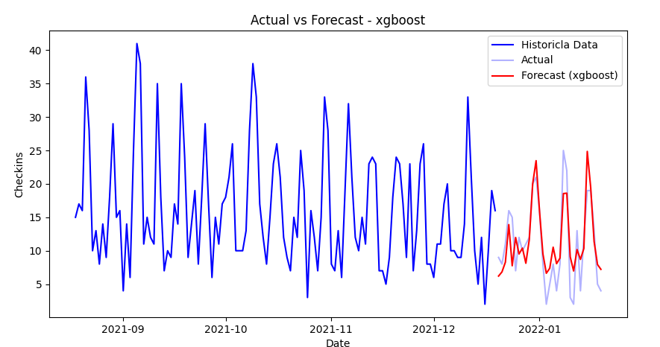
Forecasts - Holdout
Notes:
Also the horizon belongs to the covid period

Slide 27
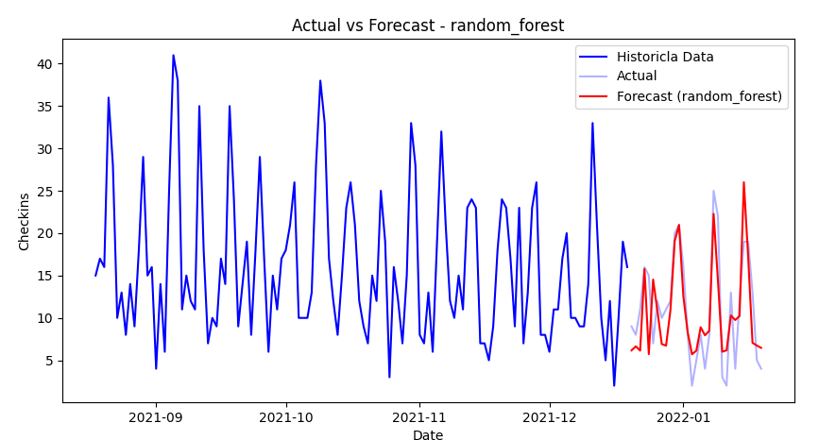
Forecasts - Holdout
Notes:
Also the horizon belongs to the covid period

Slide 28
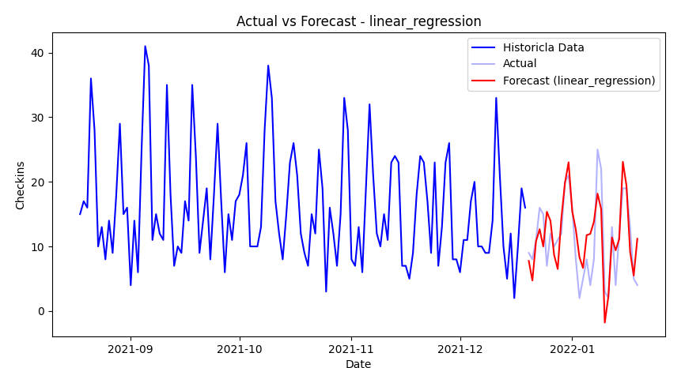
Forecasts - Holdout
Note that a simple linear regression performed as well as xgboost and random forest models, which are more robust ones. It occurs due to strong correlation seen with “lag_1_week” feature.
Notes:
Also the horizon belongs to the covid period

Slide 29
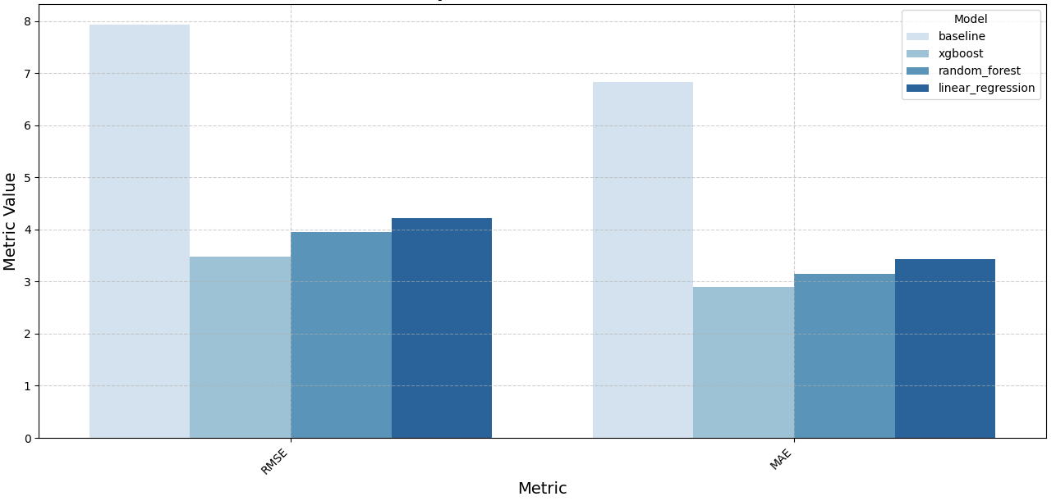
Evaluation
In general, all regression models outperformed the baseline model by around the half error. The best one in terms of RMSE was the XGBoost algorithm. The choice by RMSE in that case is because we have many spikes in our time series, so we would like to reduce the impact of outliers in our predictions.
Notes:
Baseline not so bad, but by chance

Slide 30
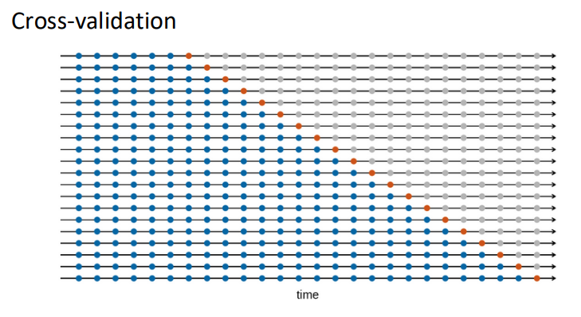
Forecasts - Cross-validation
We also applied cross-validation as experience in our project, training a new model for each day of our horizon, and increasing by one unit our training set at each iteration.
Notes:
Multiple models

Slide 31
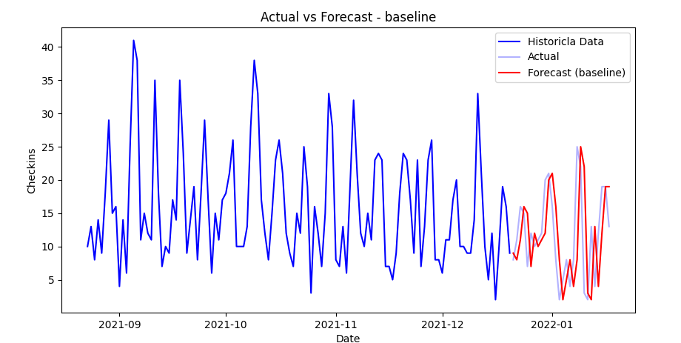
Forecasts - Cross-validation
We can see a difference in our baseline, due to the difference in how we are predicting. Since the last value is being propagated, and every horizon day is a new model, the baseline is basically the test set shifted by one unit to the right. It seems a good predictions in terms of match of shapes, but in terms of errors it is not.
Notes:
Also the horizon belongs to the covid period

Slide 32
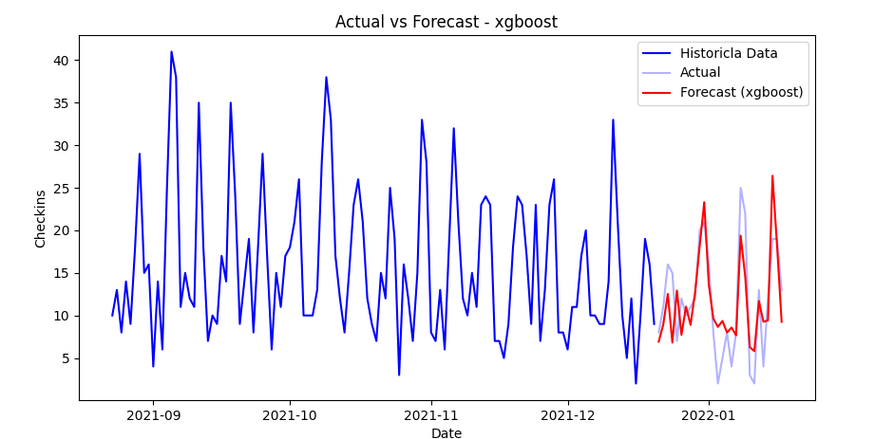
Forecasts - Cross-validation
Notes:
Also the horizon belongs to the covid period

Slide 33
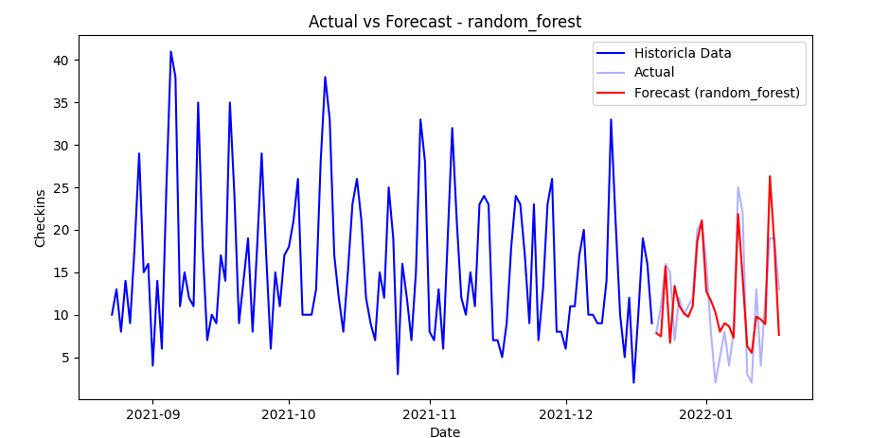
Forecasts - Cross-validation
Notes:
Also the horizon belongs to the covid period

Slide 34
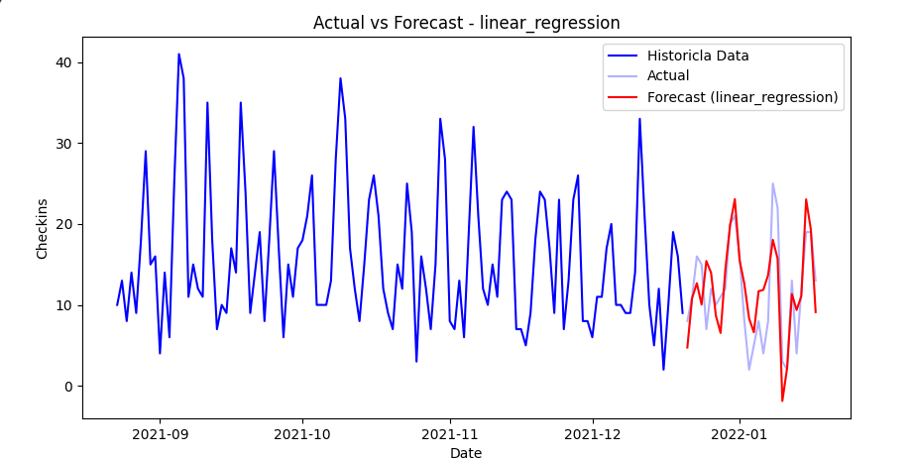
Forecasts - Cross-validation
Notes:
Also the horizon belongs to the covid period

Slide 35
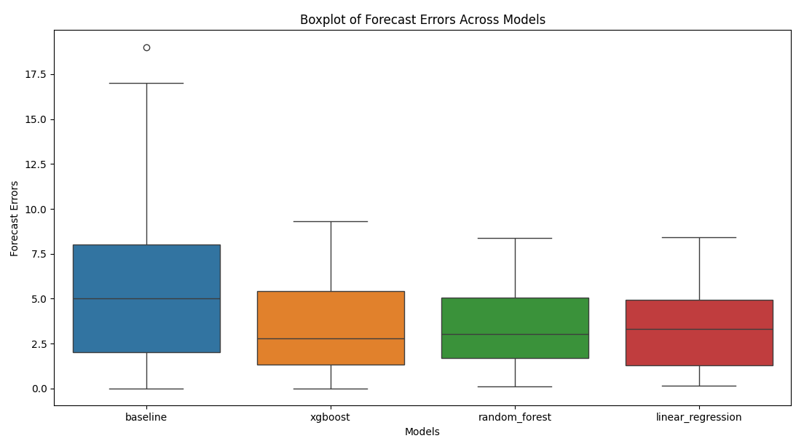
Forecasts - Cross-validation
In the end, the evaluation analysis for cross-validation is slightly different because there is only one point to measure the error for each prediction. Thus, we can just compare the distribution of the errors of every prediction. In our case, we can see that the regression models, clearly outperformed again the baseline model. We could do an ANOVA statistic test here to check the best model among them, but it is not the purpose of the analysis.
Notes:
Also the horizon belongs to the covid period

Slide 36
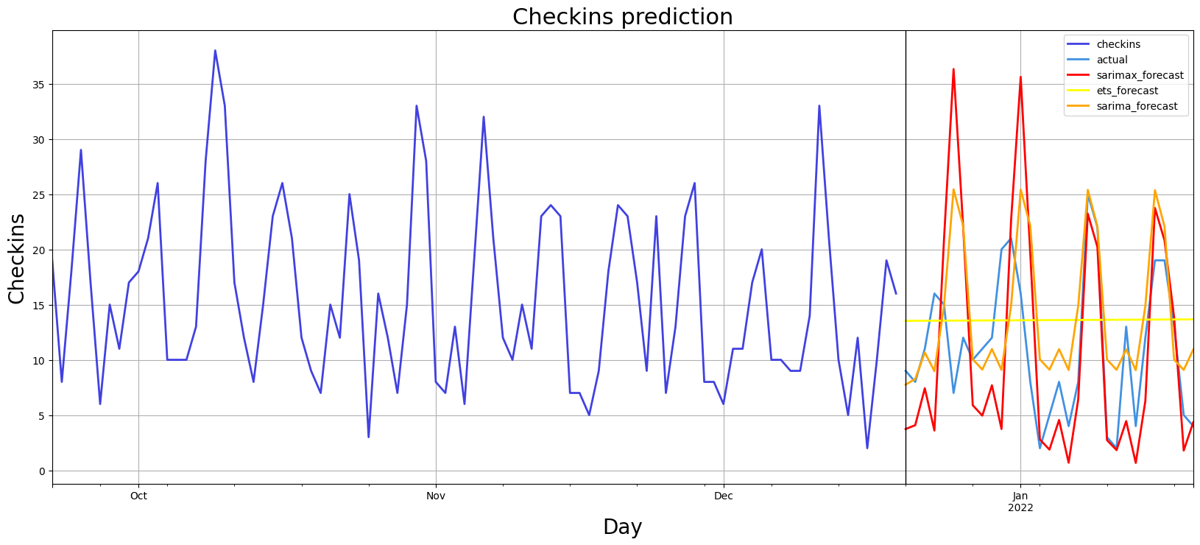
MODELS PREDICTION: Time Series Models
Notes:
Combined separate variables that should be only one.

Slide 37
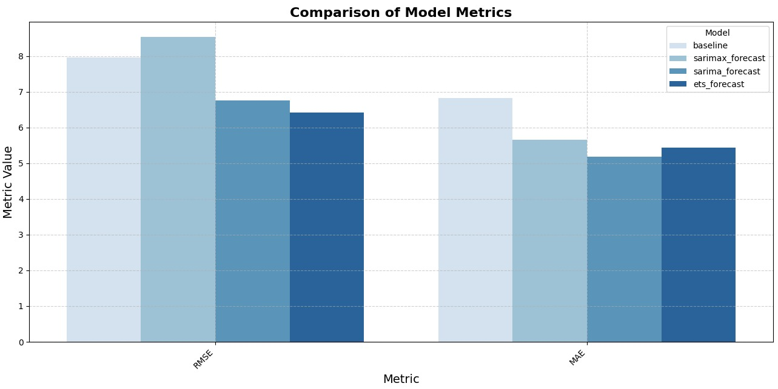
EVALUATION: Time Series Models
In general, the metrics calculated SARIMA as the best model.
However, after further analysing the fitted values and residuals, SARIMAX proved to adapt better to changes over the years.
Notes:
Combined separate variables that should be only one.

Slide 38
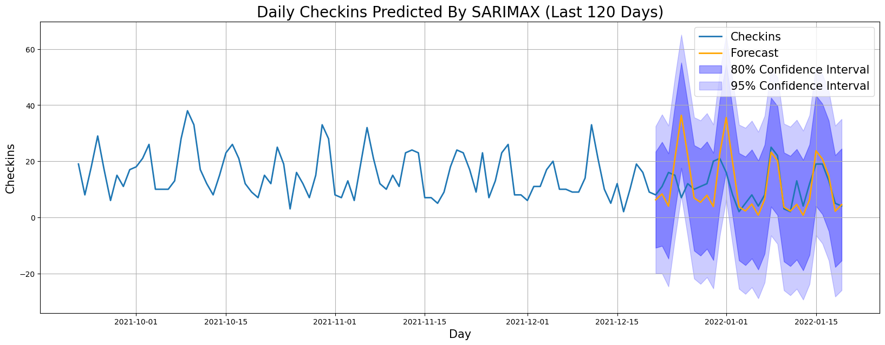
BEST TIME SERIES MODEL: SARIMAX
Notes:
Combined separate variables that should be only one.

Slide 39
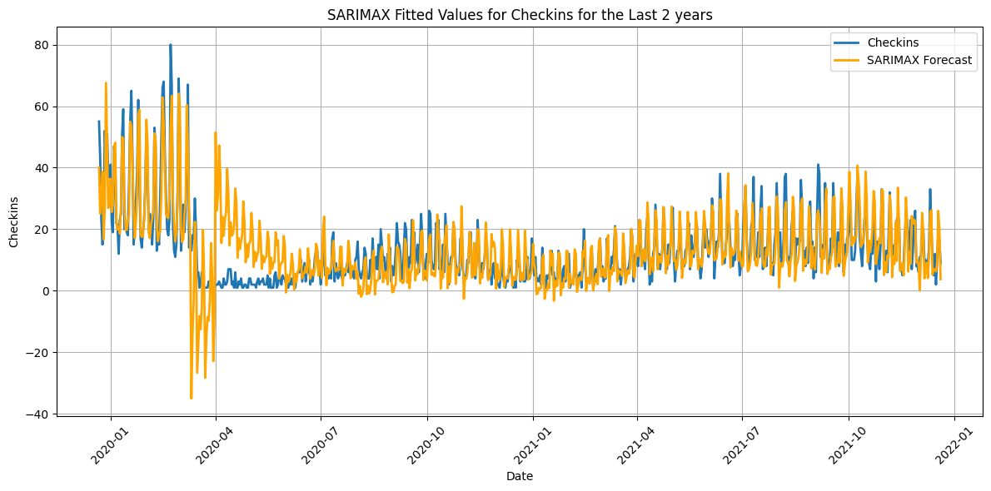
Time Series Models
In general, the model makes good predictions but has a bad adaptation in periods of high variance
Notes:
Combined separate variables that should be only one.

Slide 40
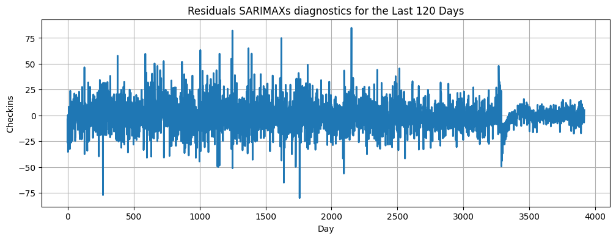
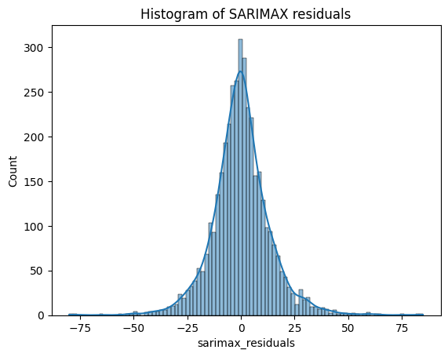
RESIDUALS DIAGNOSTIC: SARIMAX
Conclusions
The residuals of the model look like white noise and the residuals assume a normal distribution ➜ The model is well implemented.
Notes:
Combined separate variables that should be only one.

Slide 41

Thank You!

